Slide 1
Tax Calculator
Shusen Han, Jinrui Dong, Ziheng Tang

Slide 2

About This Application
The Tax Calculator is a free application that helps users to count their taxation via information provided by user, such as where they live. Besides the calculator function, once the user pay extra money, the account will be upgraded to VIP account, which can provide users many other services but not only calculator function.

Slide 3
System overview
The system consists of three parts:
UI layer, which is the part that user interacts with.
Business logic layer(Controller), which is the part that implements various functions.
Database layer, which is the part that stores users’ data.

Slide 4
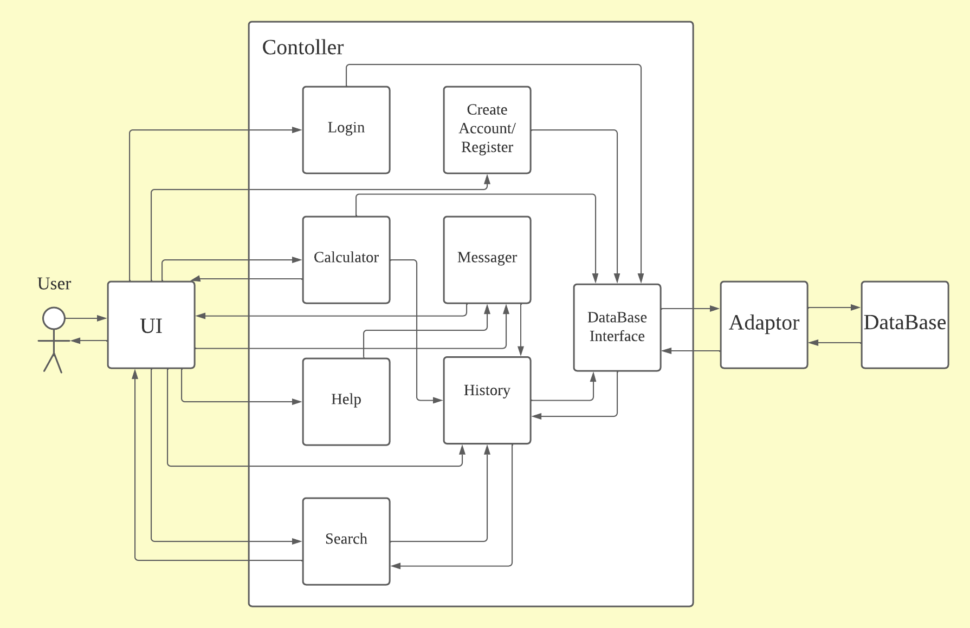
System Diagram
using the system diagram

Slide 5
Actor Identification
The user can login or Register an account.
The user can input personal information in the calculator.
The user can communicate with some persons.
The user can review the history of the calculator.

Slide 6
Architectural Style
Three-Tier Architecture
UI layer, which is the part that user interacts with.
Business logic layer(Controller), which is the part that implements various functions.
Database layer, which is the part that stores users’ data.

Slide 7
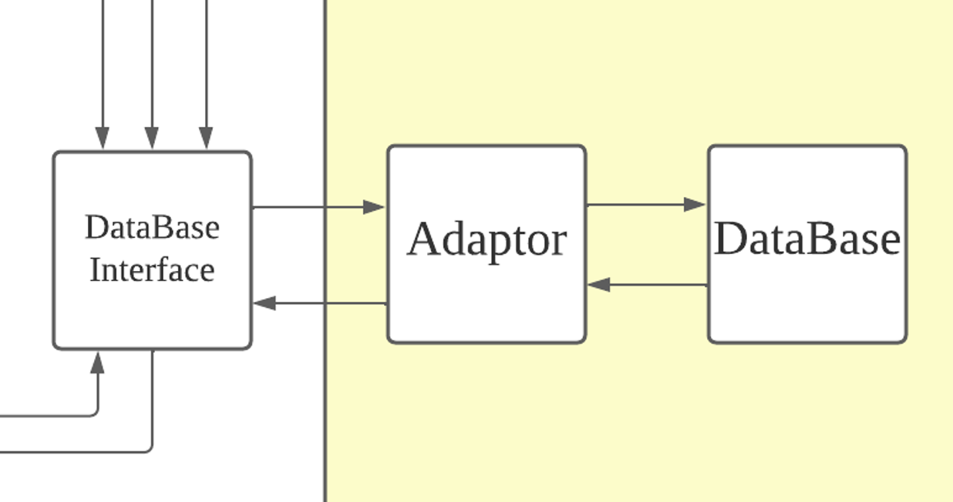
Design Pattern
Adaptor Design Pattern
Connect the business logic layer and service layer

Slide 8
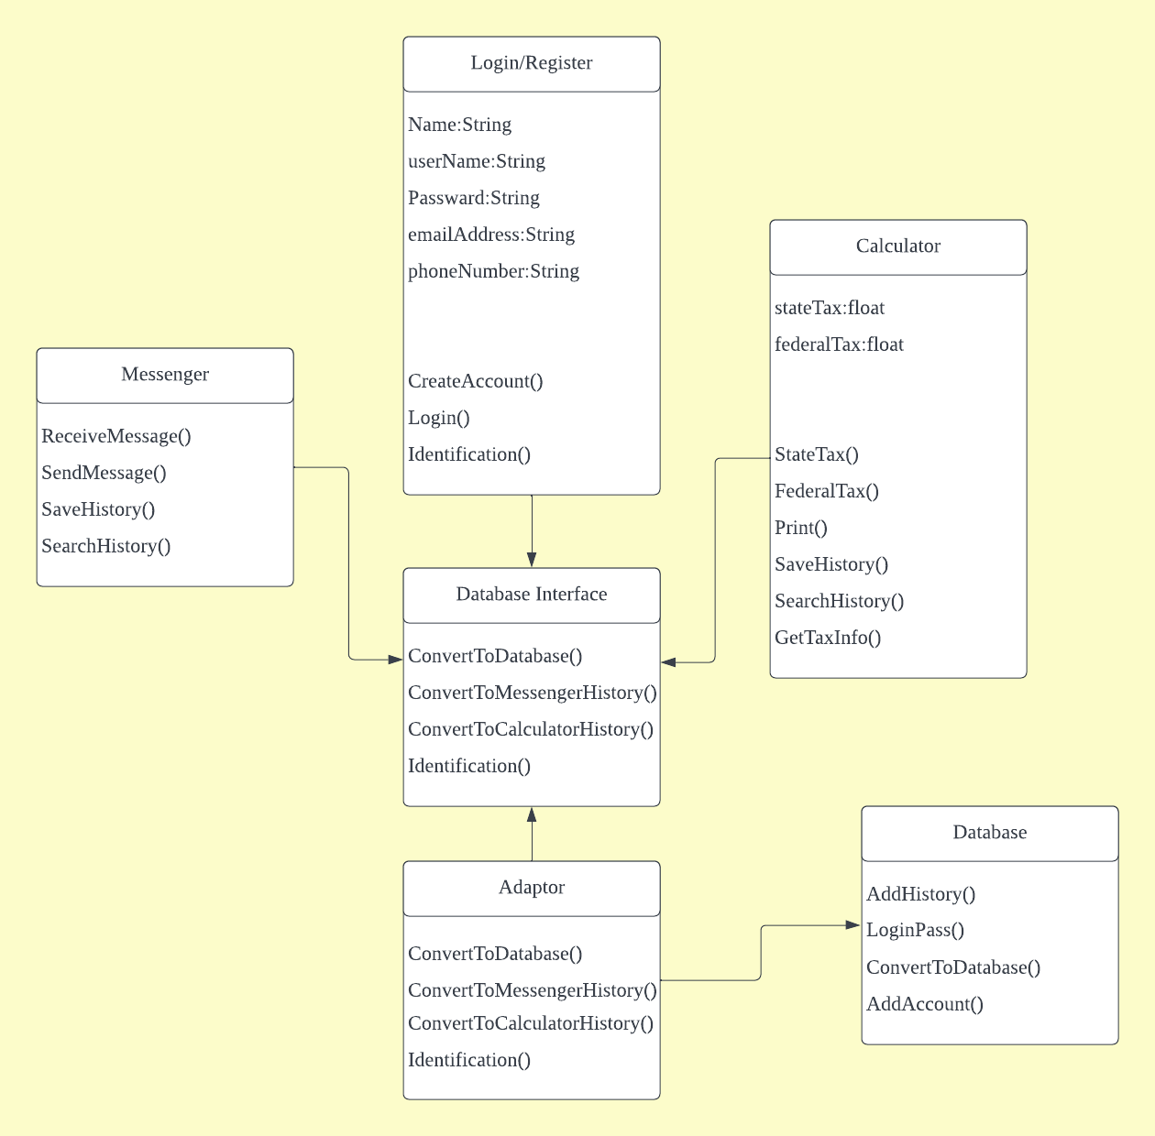
Class Diagram

Slide 9
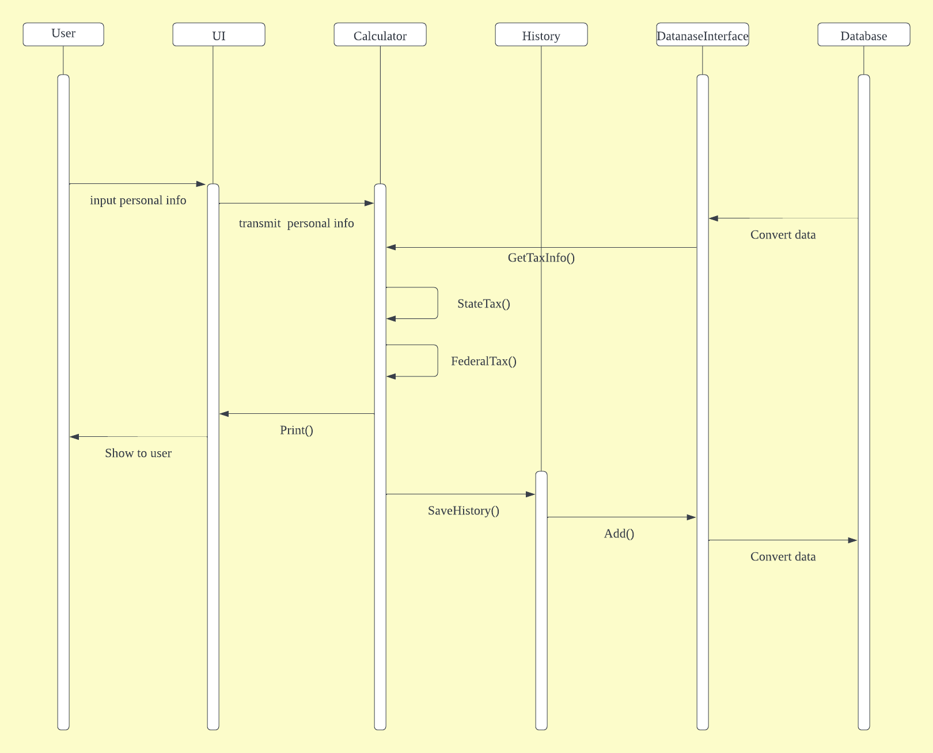
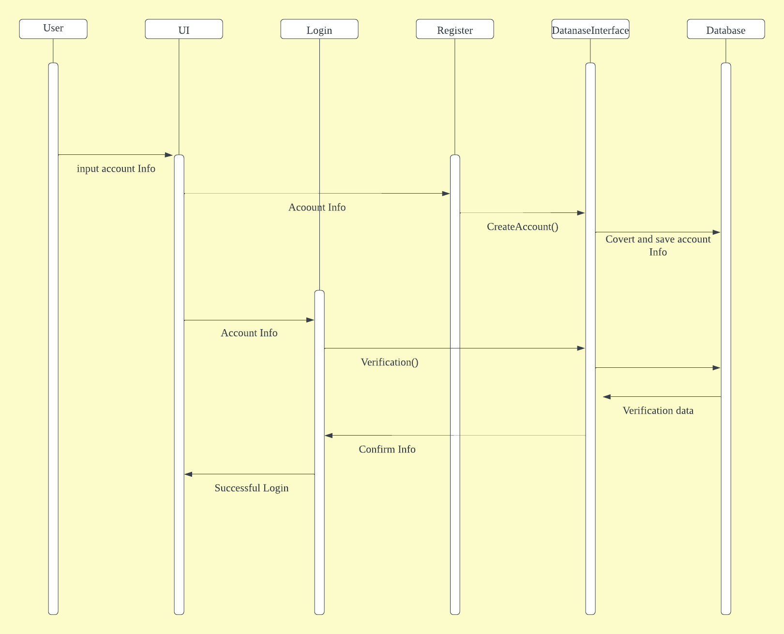
Sequence Diagram

Slide 10
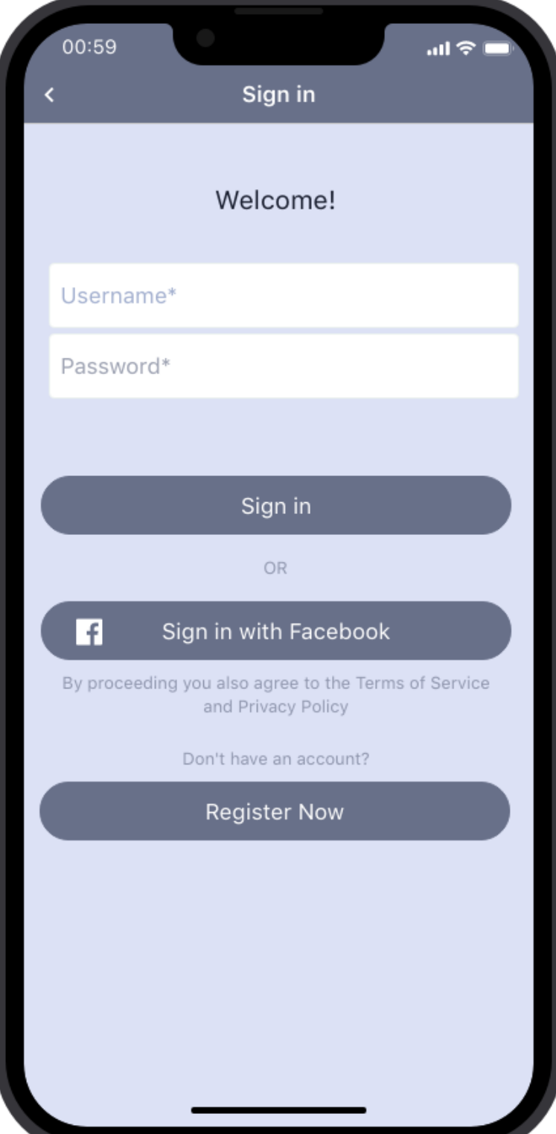
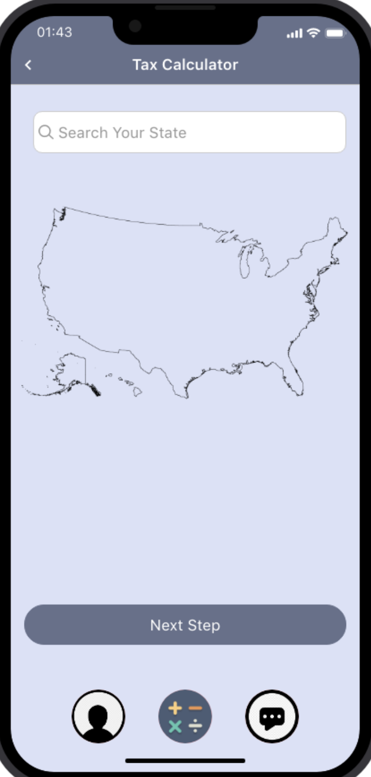
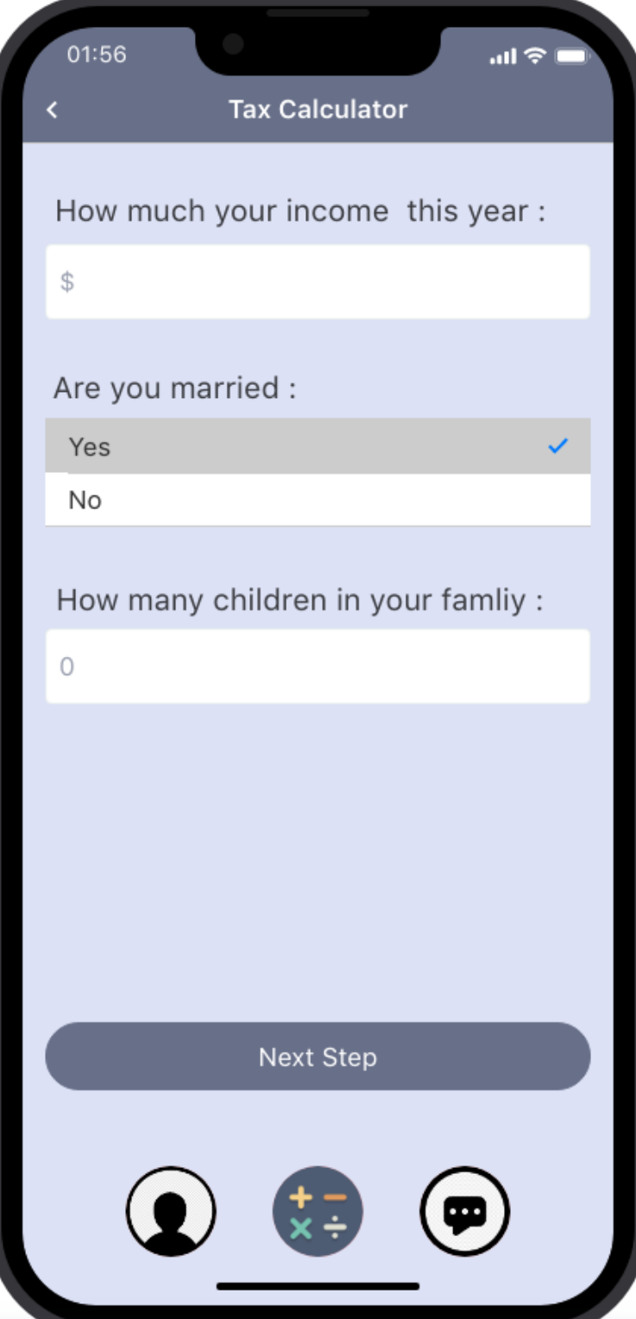
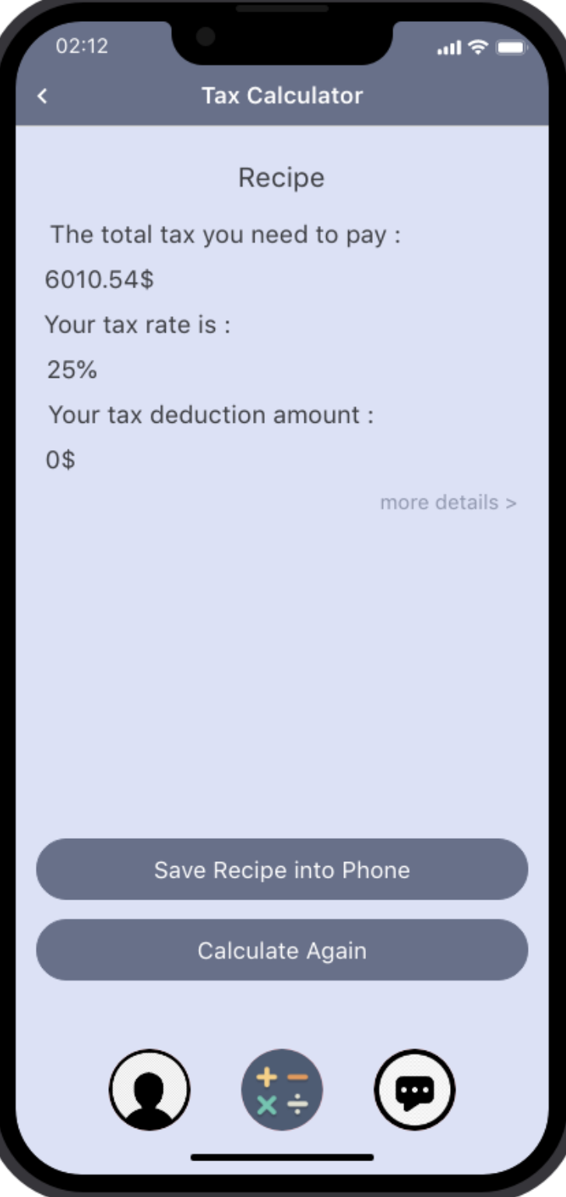
Mockup

Slide 11
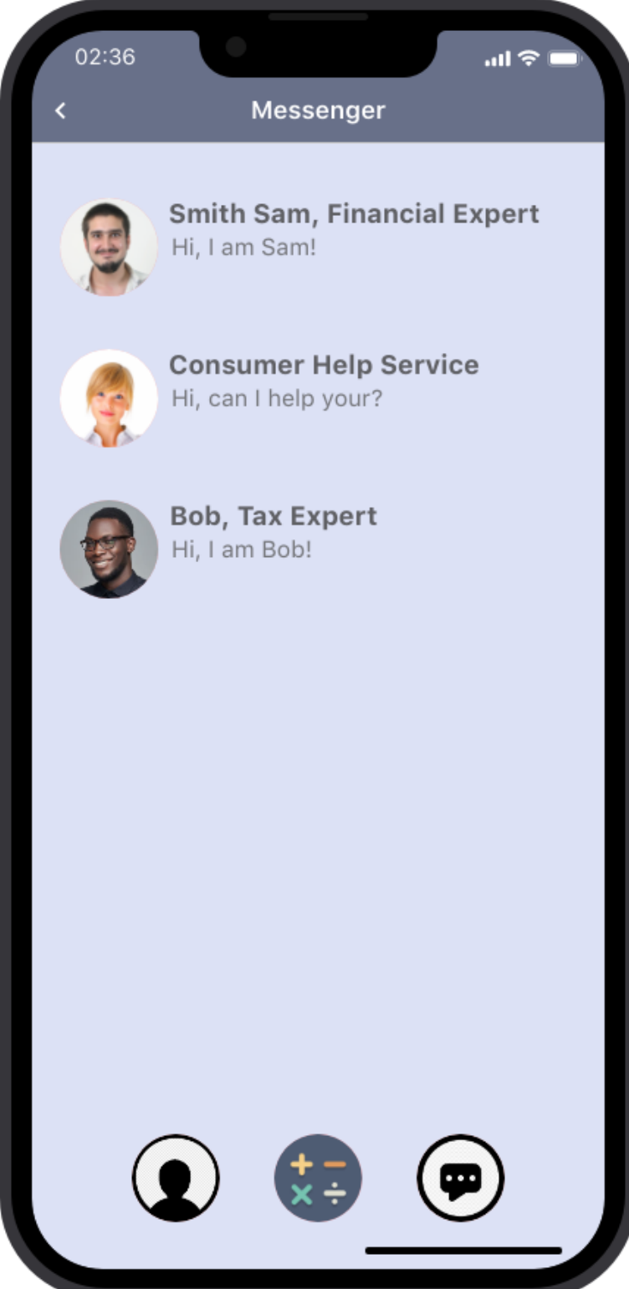
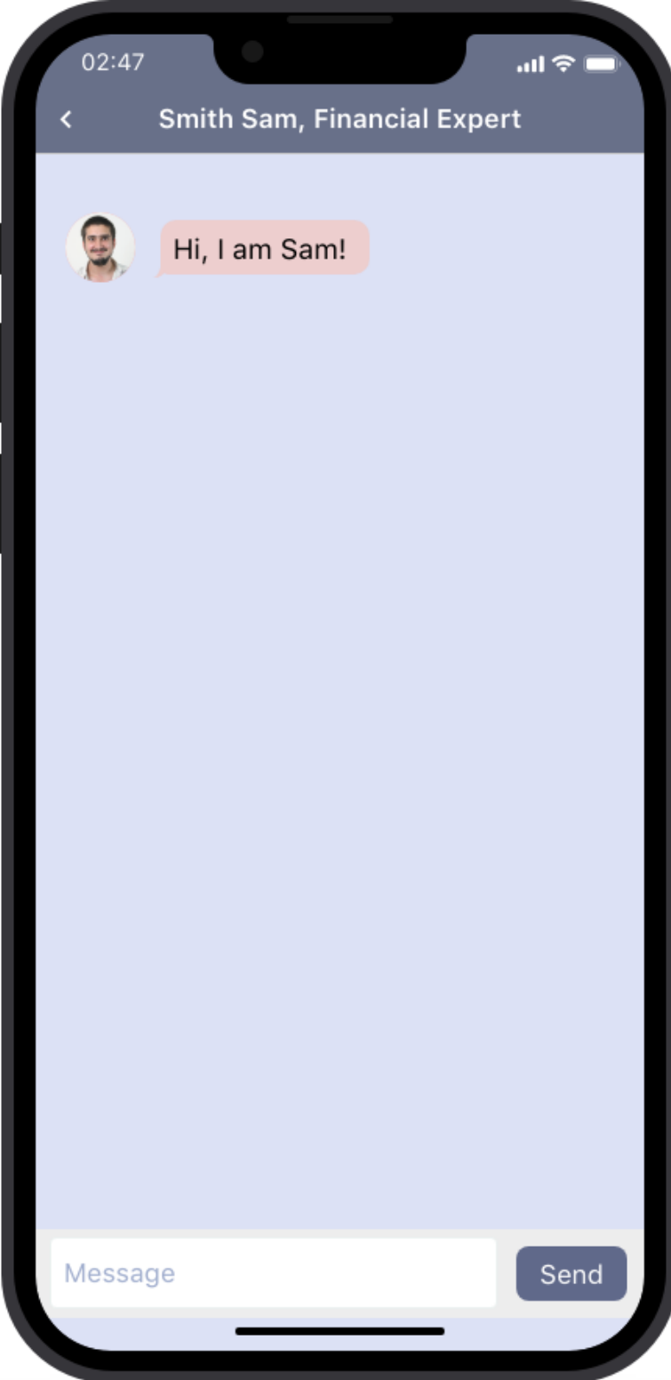
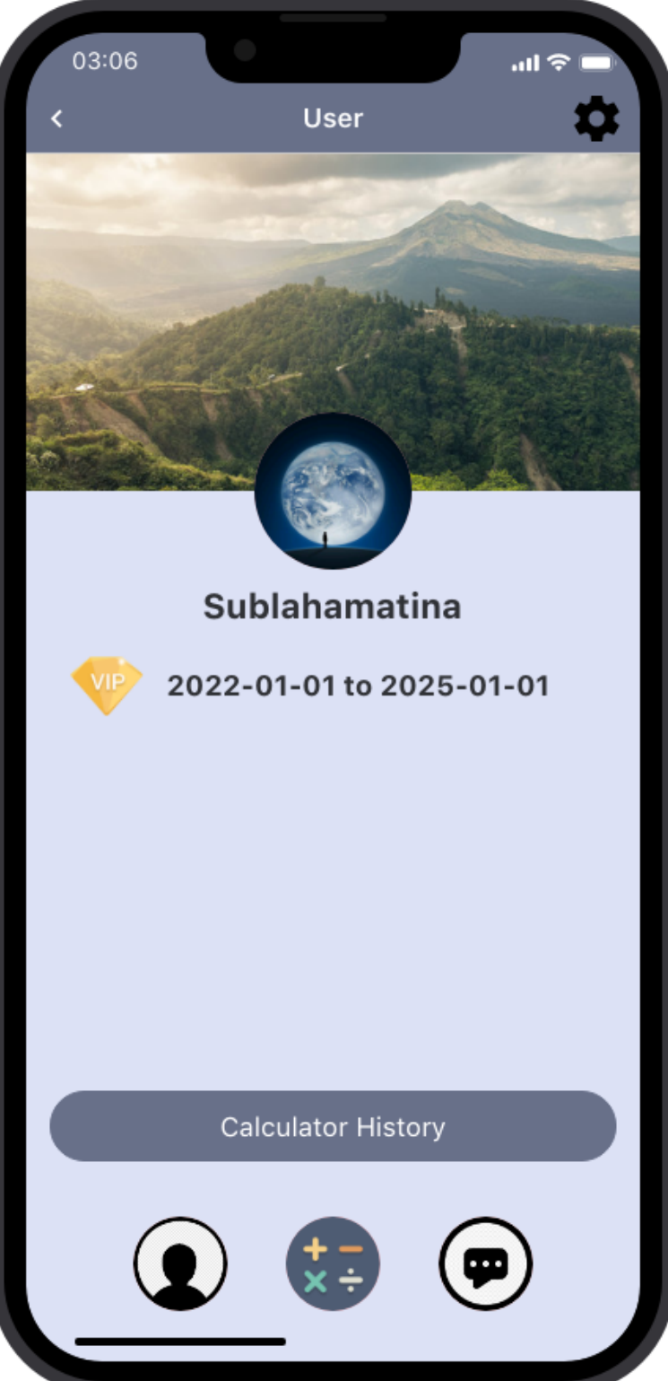
Mockup

Slide 12
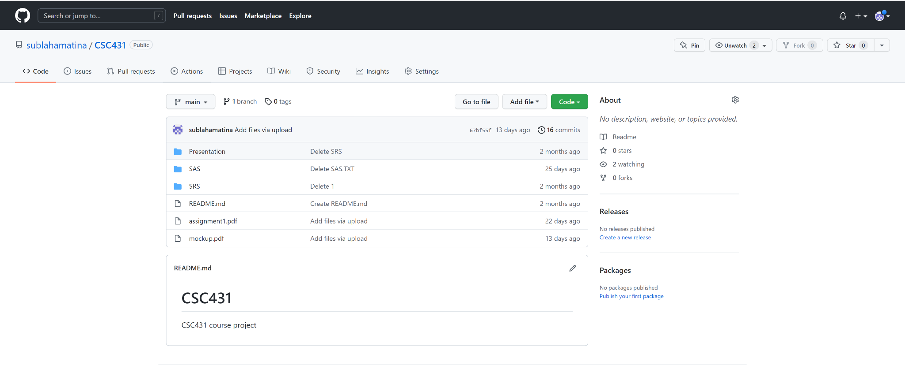
Closing slide with GitHub link
Github Link: https://github.com/sublahamatina/CSC431

